Slide 1
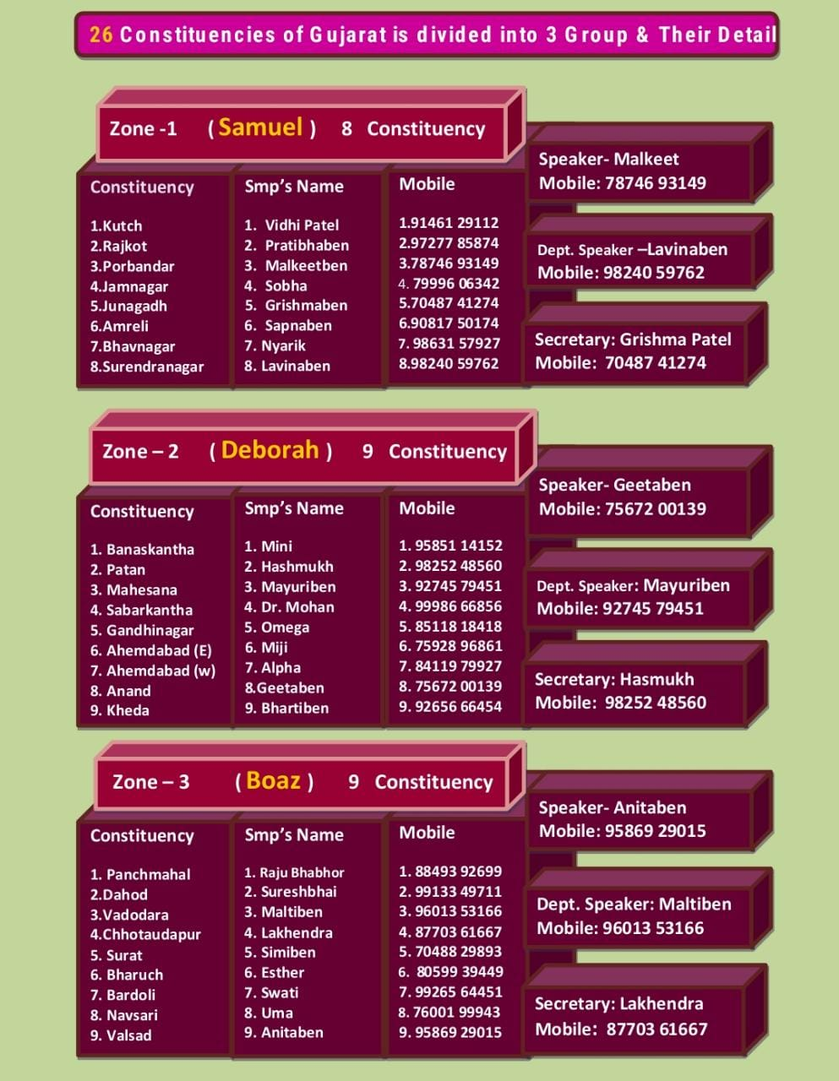

Slide 2
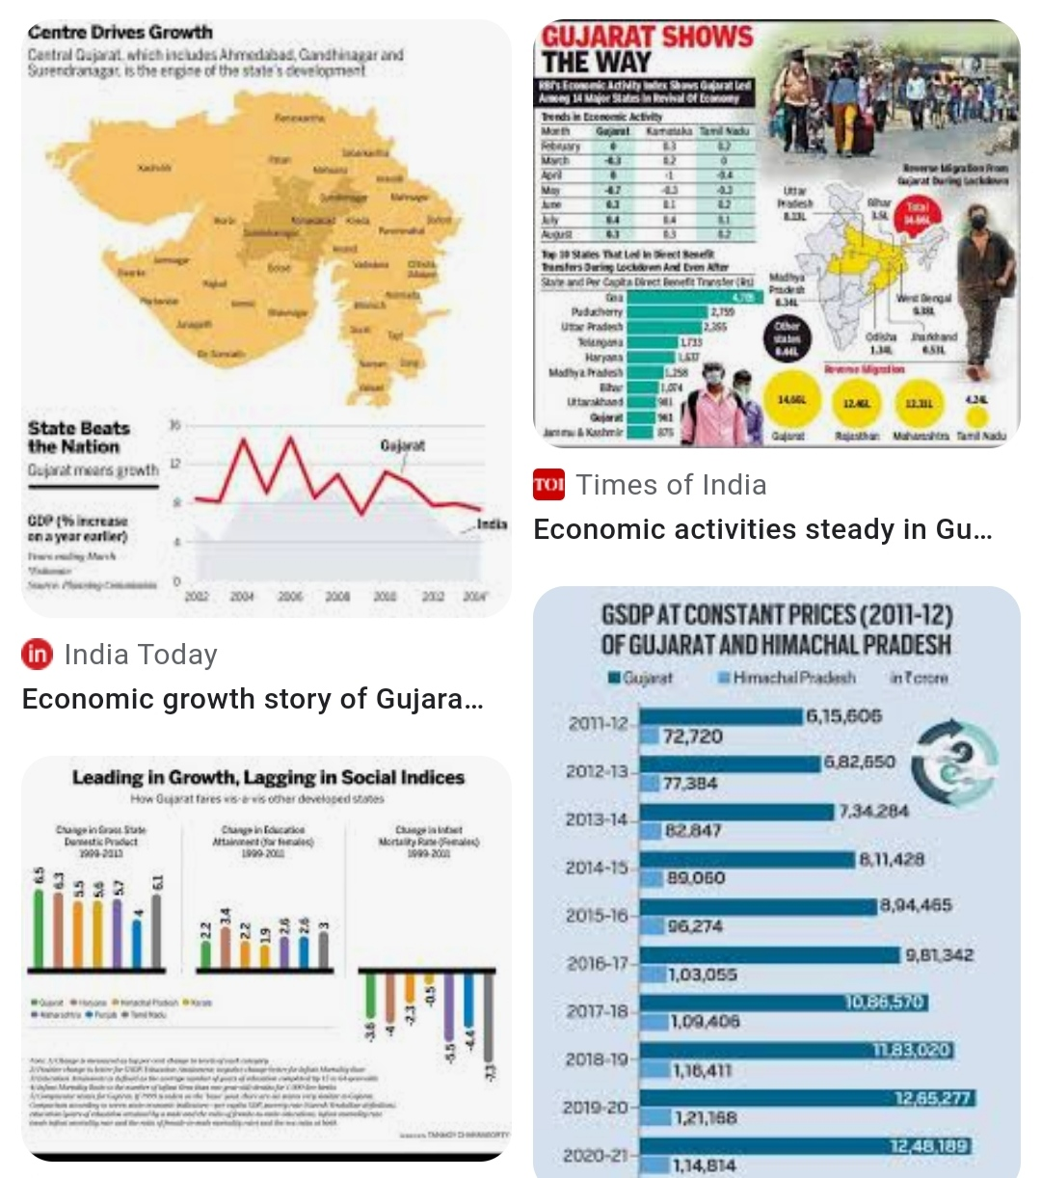
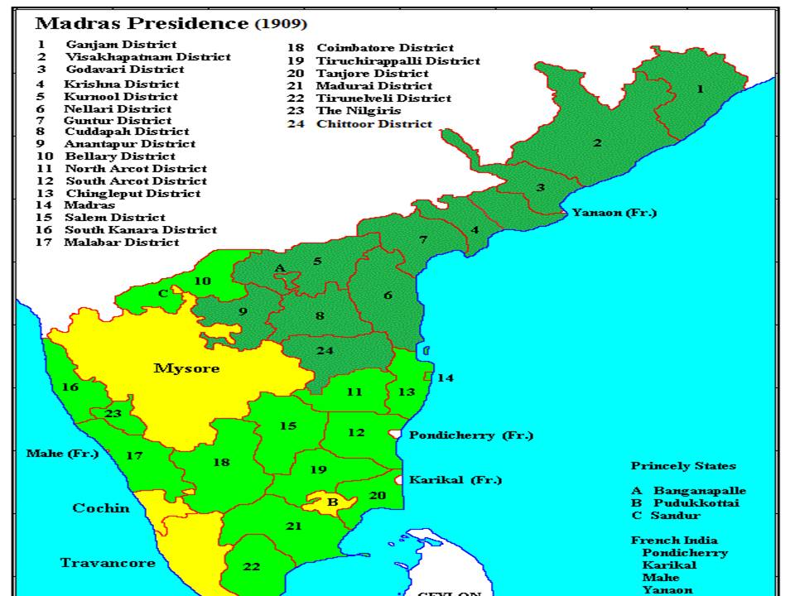

Lord we bless you for our State

Slide 3
We Bless you O Lord!
For this wonderful Land of GUjRAT &that is within
Deu 32:13 He made him ride on the high places of the land, and he ate the produce of the field, and he suckled him with honey out of the rock, and oil out of the flinty rock.

Slide 4
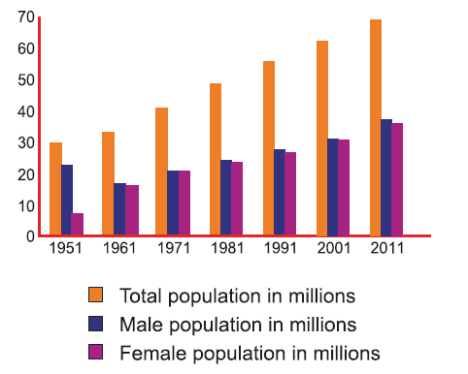
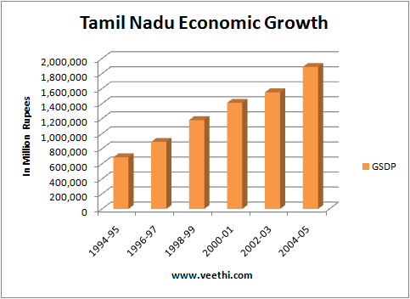
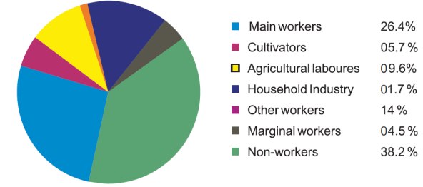

Slide 5



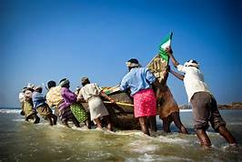
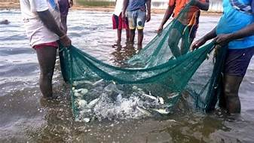
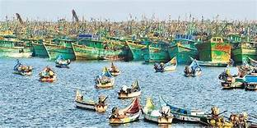
Gujarat Economy
Agriculture, fishing, and forestry
Agriculture is the mainstay of life for about ha
Gujrat is one of India’s top fish producers, with most of the yield coming from marine operations, although there also are many inland fisheries.
In addition, the state has an active forestry sector, with pulpwood, babul (a type of acacia that yields valuable tannin), firewood, bamboo, and teak among the primary products.

Slide 6

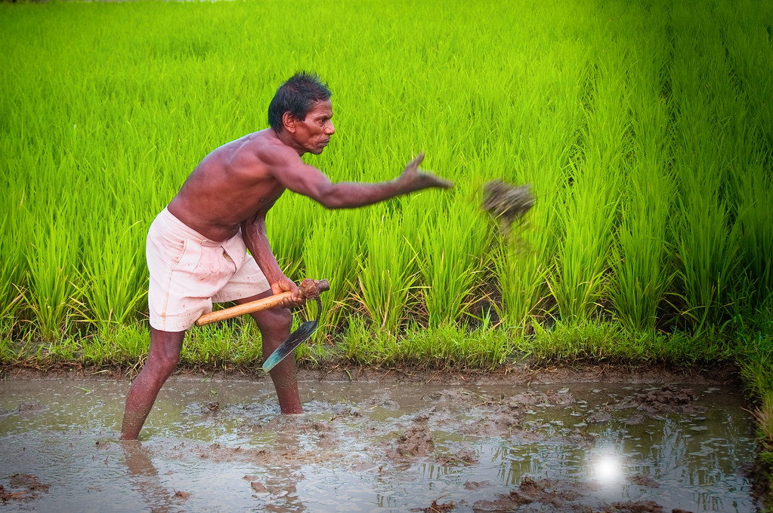
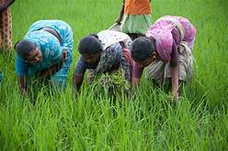
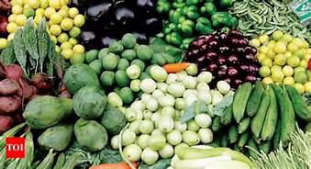


Slide 7
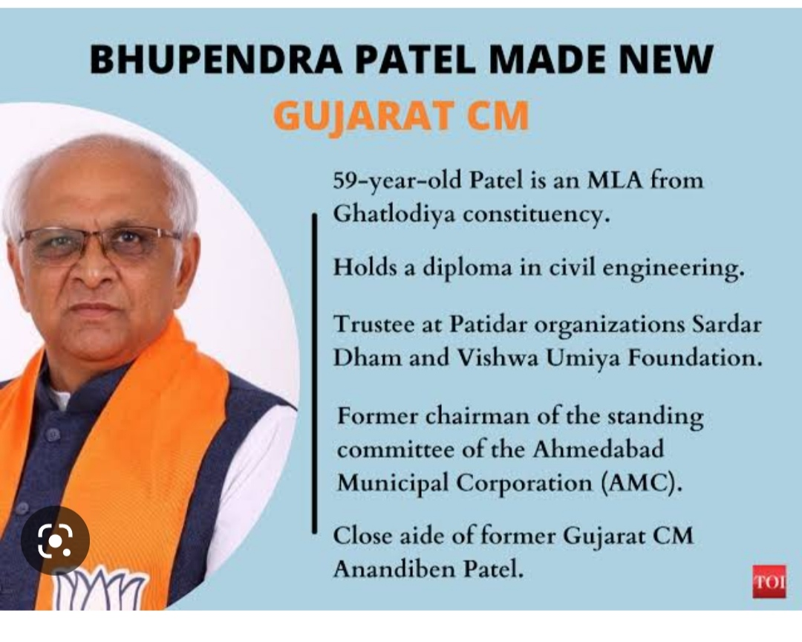
Chief minister of GUJRAT

Slide 8

Thank you Lord for all your servants who brought Jesus Government to our land through Gospel!

Slide 9
Gujrat Fellowship
MeetingPraise Report
May2024
“For where two or three are
gathered in my name, Iam there
among them .”(Matthew 18:20)
Fellowship meeting was conducted
in Gujarat on 5th may2024 from
10:00 am to3:00 pm. We praise God
for 33 soldiers were present. Sol.
Snehal said the opening prayer &
slogan followed by an introduction
of the fellowship meeting and its
purpose given by Sol. Mohan. All the
soldiers were able to spend a
wonderful time of worship in the
presence of God led by Sol.
Raymond. In between the worship
some of the soldiers were given
the responsibility by the worship
coordinator to pray while repenting
for violating the responsibility to
start new troop Churches in the
constituency also praising God for
the ongoing troop Churches.
Sol. Malkeet shared the word .
This was followed by the Lord’s
supper led by Sol. Mohan
led the intercessory prayer. Sols.
came together and prayed for
the upcoming elections and for all
the constituencies. Praise report
was given by the members of the
constituency.Testimonies were
shared by the members.
This was followed by lunch break.
It was amazing to see various type
of food .
Soldiers enjoyed the
delicious meal.

Slide 10
Testimony of Bharti Sister
आज ऐसतरसिस्टर 91पढन कर रहे थे तो मेने देखा कि उसके बगल मे वो बच्चे👶👶 को गोदी में ले के खड़े हैं.
राजाओं के राजा👑 प्रभु ओ के प्रभु के येशु मसीहा के नाम पर मे भविष्य वानी करती हु की
देखो, बच्चे यहोवा के दिए हुए भाग हैं,
गर्भ का फल उसकी ओर से प्रतिफल है।
भजन संहिता 127.3
इस भविष्य वानी को 2024 कि अनदर पुरी हो गी
येशु मसीहा के लहु ओर पवित्र आत्मा के नाम पर डिक्ररी को सील करती हु
आमीन हालेलुया.

Slide 11
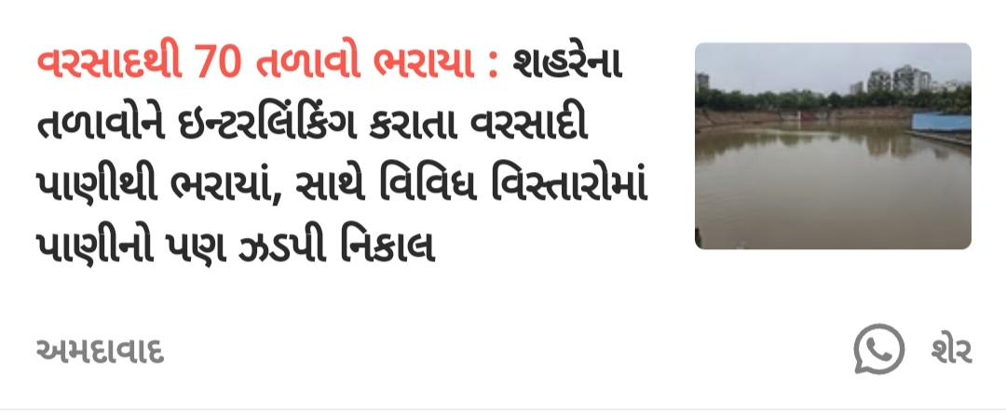

Slide 12
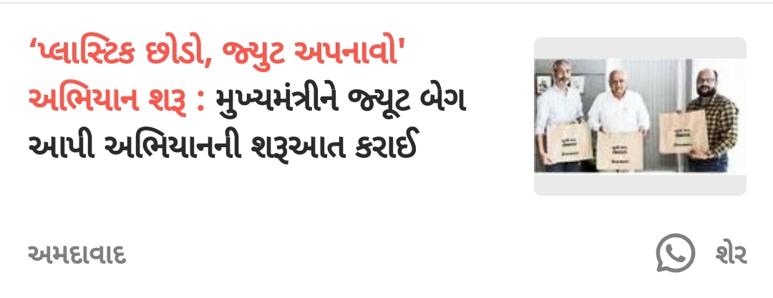

Slide 13
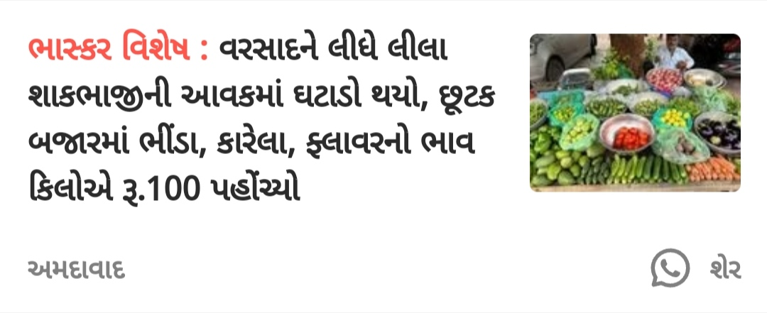

Slide 14
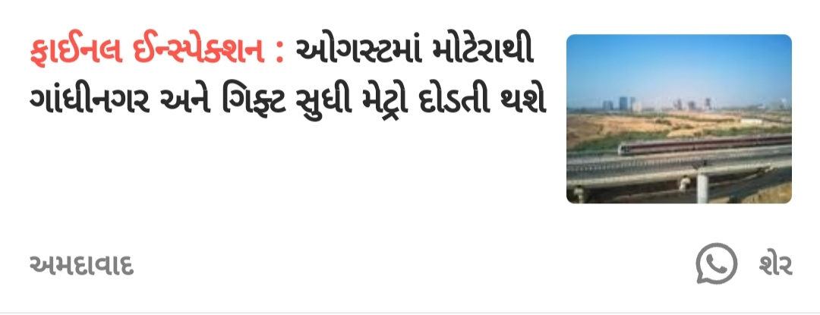

Slide 15
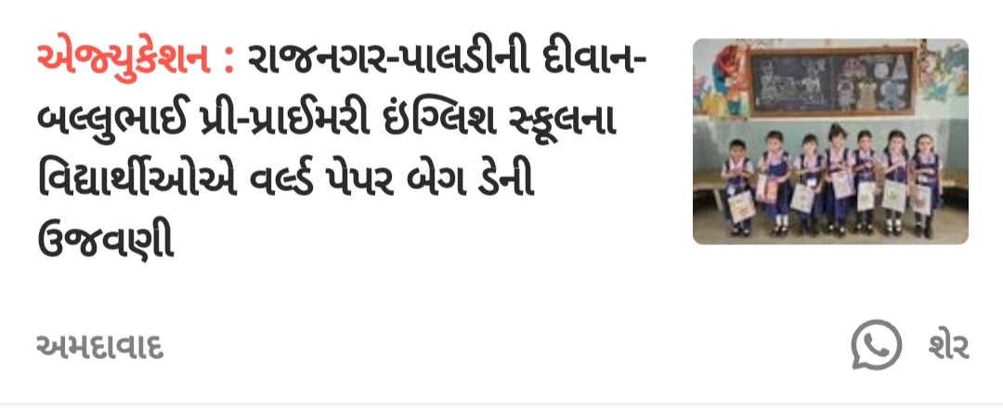

Slide 16
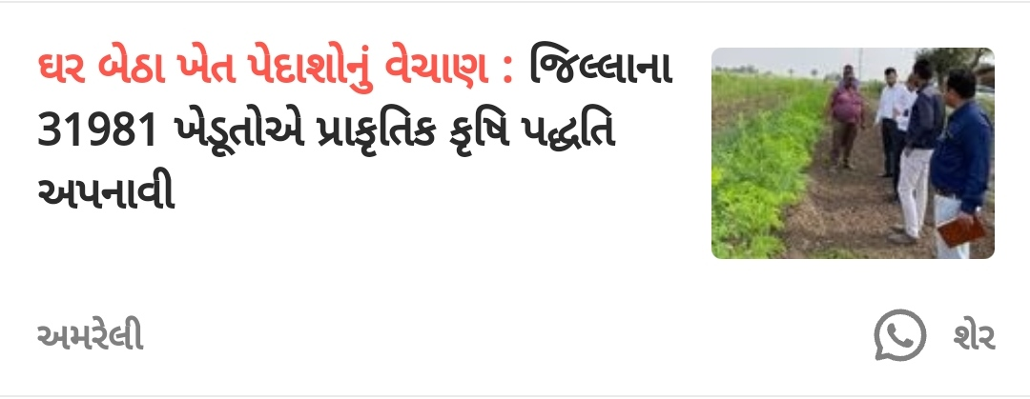

Slide 17
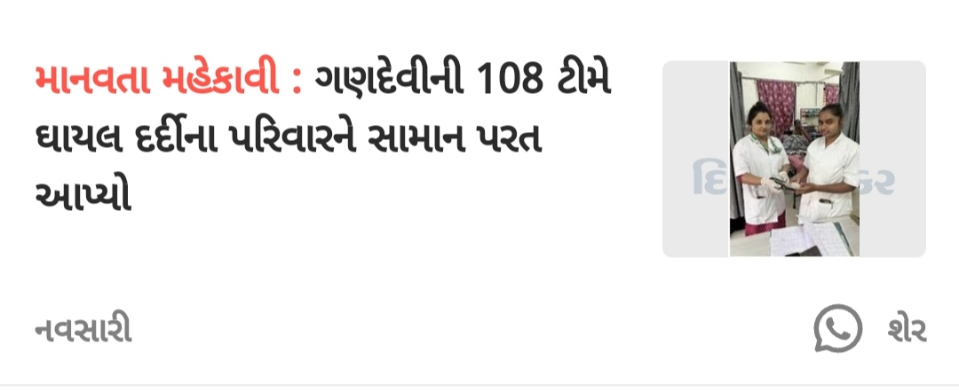

Slide 18
Gujarat, Night Prayer Report, 2024
Date : 6/6/2024
Time : 9.30pm to 4.00am
Participants: 20 elders
& 5 Children were present.
Place : Baroda.
It started with opening prayer followed by pledge & worship. Message was shared by Hashmukh brother. After that on various points prayer was done. It was a successful night Prayer. We experience the presence of our heavenly Father and Holy spirit.
Testimony: There was a person called Rakeshbhai was a Show Fumes in the night Prayer. Praise the Lord.

Slide 19
New core team member
July to December 2024
Speaker -- sol. Bharti Meshram
Deputy speaker-- sol. Rakesh
Secretary SMP -- Sol. Uma
State Coordinator-- sol. Pushpa
Sata Secretary-- Sol. Alpha

Slide 20
-:Testimony:-
તમામ માતા-પિતા તેમજ વાલીઓને જણાવવાનું કે શિક્ષણમાં ચાલતા ભ્રષ્ટાચારને બંધ કરવા ગુજરાત સરકાર દ્વારા સિનિયર-જુનિયર કે. જી. , પ્રાથમિક તેમજ માધ્યમિક ખાનગી શાળામાં ફી નિયમનનો કાયદો બનાવેલ છે. જેના કારણે હવેથી નીચે દર્શાવેલ ફી મુજબ જ દરેક સ્કૂલોએ ફી લેવાની થાય છે જેમા કોઈ પણ પ્રકારની વધુ ફી લેવાની સરકારે છૂટ આપેલ નથી. આમ છતા , જો કોઈ સ્કૂલ આપની પાસે આપના સંતાનોની સ્કૂલ ફી સરકારે નિર્ધારિત કરેલ ફી કરતા 1 રૂપિયો પણ વધુ ફી વસૂલે તો તે સ્કૂલની ફી ની પહોંચ સાથે અમારો સંપર્ક કરશો.
દરેક વાલિએ સરકારી નિયમ પ્રમાણે પોતાના સંતાનોની નીચે મુજબ ફી સ્કૂલોમાં ભરવાની થાય છે
⚠સિનિયર કે જી /જુનિયર કે જી /ધોરણ 1થી 8
ફી 15000 રૂપિયા
⚠ધોરણ 9 to 12 કોમર્સ
ફી 25000 રૂપિયા
⚠ધોરણ 11 & 12 સાયન્સ
ફી 27000 રૂપિયા

